Slide 1
The Impact of 2006-2012 CReSIS Summer Research Programs that Influence Students’ Choice of a STEM Related Major in College
By: Alica Reynolds, Jessica Hathaway, Malcolm McConner, Courtney Farmer, & Mentor Dr. Darnell Johnson

Slide 2
Math Team
Alicia Reynolds
Elizabeth City State University
Freshman
Jessica Hathaway
Elizabeth City State University
Freshman
Courtney Farmer
Elizabeth City State University
Sophomore
Malcolm McConner
Elizabeth City State University
Senior
Mentor: Dr. Darnell Johnson
Elizabeth City State University

Slide 3
Math Team Activities

Slide 4
Abstract
Researchers, policymakers, business, and industry have indicated that the United States will experience a future shortage of professionals in the Science, Technology, Engineering, and Mathematics (STEM) fields. Several strategies have been suggested to address this impending shortage, one of which includes increasing the representation of females and minorities in the STEM fields. In order to increase the representation of underrepresented students in the STEM fields, it is important to understand the motivational factors that impact underrepresented students’ interest in STEM academics and extracurricular programs. Research indicates that greater confidence leads to greater interest and vice versa (Denissen et al., 2007). In this paper, the mathematics research team examined the role of practical research experience during the summer for talented minority secondary students studying in STEM fields.

Slide 5
Abstract Continued
An undergraduate research mathematics team focused on the link between summer research and the choice of an undergraduate discipline. A Chi Square Statistical Test was used to examine Likert Scale results on the attitude of students participating in the 2006-2012 Center for Remote Sensing of Ice Sheets (CReSIS) Summer Research Programs for secondary students. This research was conducted at Elizabeth City State University located in northeastern North Carolina about the factors that impact underrepresented students’ choices of STEM related majors in college. Results can be used to inform and guide educators, administrators, and policy makers in developing programs and policy that support and encourage the STEM development of underrepresented students.
Keywords: Science, Technology, Engineering, and Mathematics, (STEM), Chi Square Test, Underrepresented students

Slide 6
Purpose
The purpose of this study was to explore the factors that influence underrepresented students’ choice of Science, Technology, Engineering, and Mathematics (STEM) related majors in college. The math team analyzed data from the 2006-2012 Center for Remote Sensing of Ice Sheets (CReSIS) Summer Research Programs for secondary students at Elizabeth City State University provided by the STEM assessment survey. Understanding the factors that influence underserved students’ interest in STEM will inform strategies that may potentially increase participation in these areas for this population.

Slide 7
Focus Questions
What is the impact of students participating in STEM courses in the choice of college majors?
What is the impact of students participating in CReSIS Summer Programs in the choice of college majors?
What is the impact of students participating in STEM activities/labs in the choice of college majors?
What is the impact of students using STEM curriculum in the choice of college majors?

Slide 8
Survey

Slide 9
Data/Results
This table breaks down the responses of the male & female students by grade level that once participated in the CReSIS Summer Program. A Chi Square Statistical Test was used to examine Likert Scale results on the attitude of students participating in the 2006-2012 Center for Remote Sensing of Ice Sheets (CReSIS) Summer Research Programs for secondary students.

Slide 10
Table 1. Frequency Distribution for Participant Demographics
Grade level | 7 | 8 | 9 | 10 | 11 | 12 | College
Male | 1 | 4 | 5 | 9 | 12 | 8 | 4
Female | 2 | 8 | 14 | 12 | 8 | 4 | 7
Total | 3 | 12 | 19 | 21 | 20 | 12 | 11
The participants in the summer programs consisted of 133 secondary school students from rural, urban and suburban northeastern North Carolina and urban Portsmouth, Virginia.
56 % of students responding were secondary school girls
44 % of students responding were secondary school boys
74 % response rate for STEM surveys
Participants’ grades ranged from 7th grade to college with a median grade level was 11th grade for males and 10th grade for females.

Slide 11
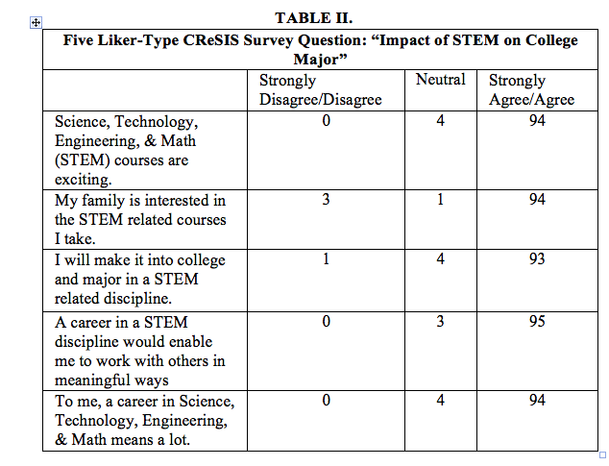
CReSIS Survey Questions Group A

Slide 12
CReSIS Survey Questions Group A
1A. 95% of the students, male and female, agreed that the STEM courses were exciting. 5% said that they were neutral in their opinions of STEM classes.
12A. Approximately 94% of the participants have family members that are interested in the STEM related courses, 3% disagreed, 1% was neutral.
17A. Approximately 93% of males & females agreed that majoring in STEM. 3% were neutral and 2% disagreed.
19A. Approximately 95% agreed that a career in STEM discipline would enable them to work with others in meaningful ways, 0% was neutral and 3% disagreed.
20A. Approximately 94% said that a career of Science, Technology, Engineering, & Math meant a lot to them, 0% disagreed and 4% were neutral.

Slide 13
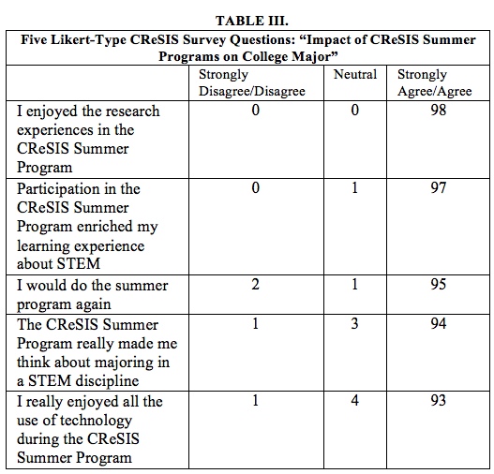
CReSIS Survey Questions Group B

Slide 14
CReSIS Survey Questions Group B
2B. 100% of the students males and females, agree that their experiences in the CReSIS summer program.
6B. Approximately 97% of the participants agreed that the CReSIS summer program enriched their learning in STEM, 0% disagree and 1% neutral.
7B. Approximately 95% of the participants agree that they would do the program again and 2% disagree, 1% neutral.
14B. Approximately 94% of the students agreed that the CReSIS Summer Program made them think about majoring in STEM, 1% disagreed and 3% neutral.
16B. Approximately 93% of males & females agreed that they enjoyed all the use of technology during the CReSIS summer program. 4% was neutral and 1% disagreed.

Slide 15
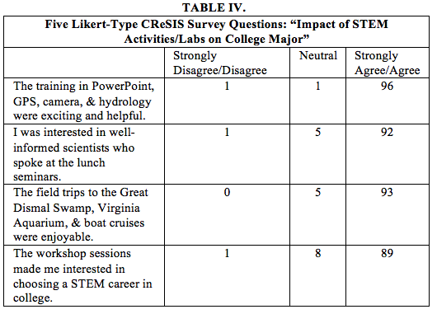
CReSIS Survey Questions Group C

Slide 16
CReSIS Survey Questions Group C
3C. 98% of the students males and females, agree that the various trainings under CReSIS were helpful. 1% said that they disagree about the various program exercises and another 1% were neutral about their experiences.
4C. 94% of the students agreed that they were interested in the lecturer at the lunch seminar.
1% of the males did not enjoy the lunch seminar and the other 5% of the students had neutral feelings about the lunch seminar.
5C. 95% of the students agreed that the field trips were enjoyable to them. 7% of the males had neutral feelings about the field trip. 3% of the female students, also had neutral experiences of the field trips.
10C. Approximately 89% of participants agree the workshop sessions made them interested in choosing a STEM career in college, 1% disagree, 8% neutral.

Slide 17
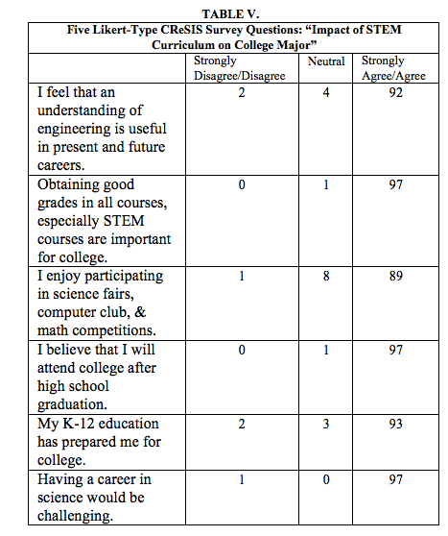
CReSIS Survey Questions Group D

Slide 18
CReSIS Survey Questions Group D
8D. Approximately 92% of the participants agree that they feel that they understanding of engineering is useful in present and future careers, 2% disagree, 4% neutral.
9D. Approximately 97% of the participants agree obtaining good grades in all courses, especially STEM courses are important for college, 0% disagree, 1% neutral.
11D. Approximately 89% of the participants enjoy science fairs, computer clubs and math competitions, 1% disagreed, and 8% was neutral.
13D. Approximately 94% of the students agreed that they will attend college after graduating, 3% disagreed, 1% was neutral.
15D. Approximately 93% of students agreed that their K-12 education prepared them for college, 2% disagreed, 3% was neutral.
18D. Approximately 97% agreed that science would be a challenging career, 1% disagreed and 0% were neutral.

Slide 19
Data/Results
The Chi-Square Test showed a comparison of observed and expected values which are listed above and concludes that the impact of the CReSIS Summer Program would be considered as a positive factor to influence students in this survey to choice a STEM related major in college. The significance level for all questions are less than 20% and conclude that males are independent of females in choosing STEM as a college major. The Chi Square indicates whether a statistically significant relationship exists.

Slide 20
Conclusion
After analyzing our data it was concluded that the students who participated in the CReSIS Summer Programs through the years 2006-2012 were positively impacted. The CReSIS program has done an effective job exposing underserved students to STEM related fields. CReSIS will continue to support secondary students and preparing them for the rigorous, yet engaging content of science, technology, engineering and mathematics. Future CReSIS programs will contribute to encourage students in their pursuit of a major and career in STEM.

Slide 21
Future Work
The future research will focus on tracking the progress of the underrepresented students that participated in the 2006-2012 CReSIS Summer Programs and who are currently enrolled in college. Data will be collected concerning their choice of college and major; further reflecting the impact of their involvement in CReSIS programs and STEM activities. Information sharing with CReSIS partners and the boarder community of these findings.

Slide 22
Acknowledgements
The 2013 URE Math Team would like to thank:
CERSER Principal Investigator: Dr. Linda B. Hayden
Mentor: Dr. Darnell Johnson
Students that participated in the CReSIS summer programs past, present and future

Slide 23
Questions?

